Slide 1

Corporate Training Setup
.NET Training

Slide 2
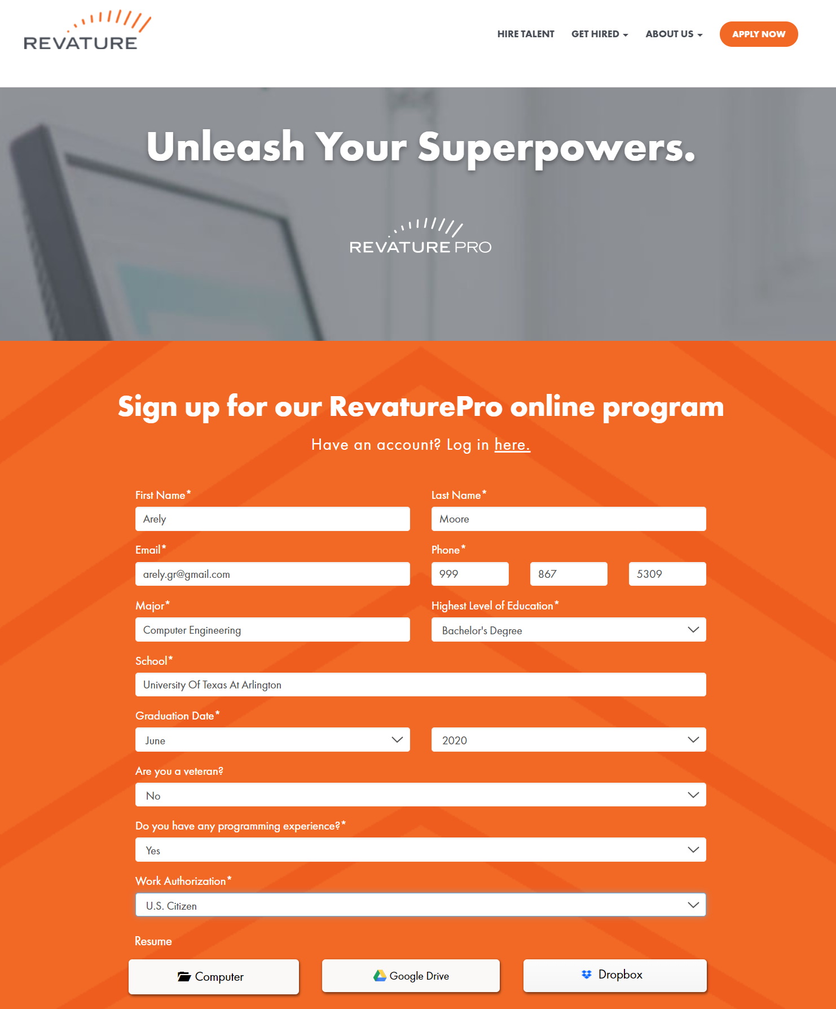
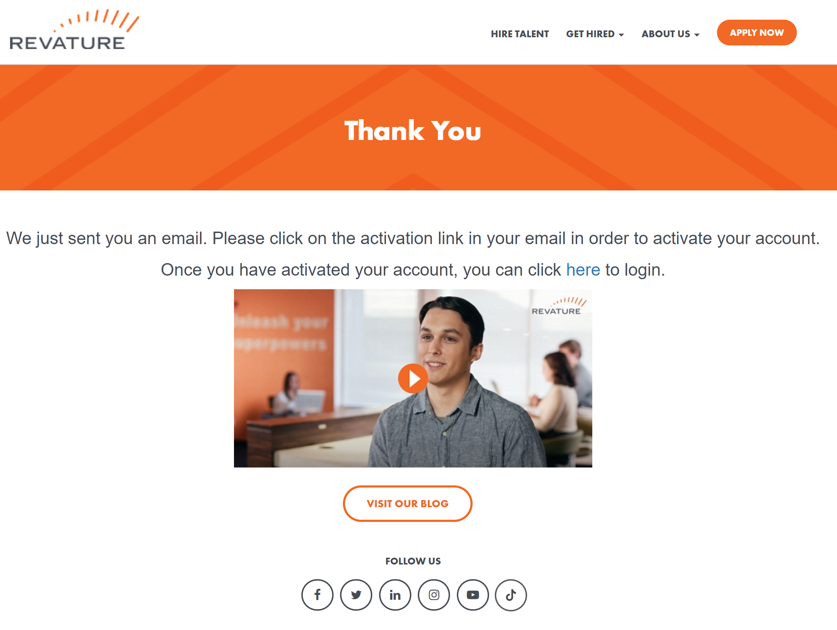
Revature Pro Setup https://app.revature.com/login https://revature.com/signup/
Go to the signup link and register for a RevaturePro account. This is necessary to be assigned to the class.
Fill in the required information using your professional email.
Don’t worry about uploading a resume.
Click SUBMIT.
Go to your professional email to verify your registration.

Slide 3
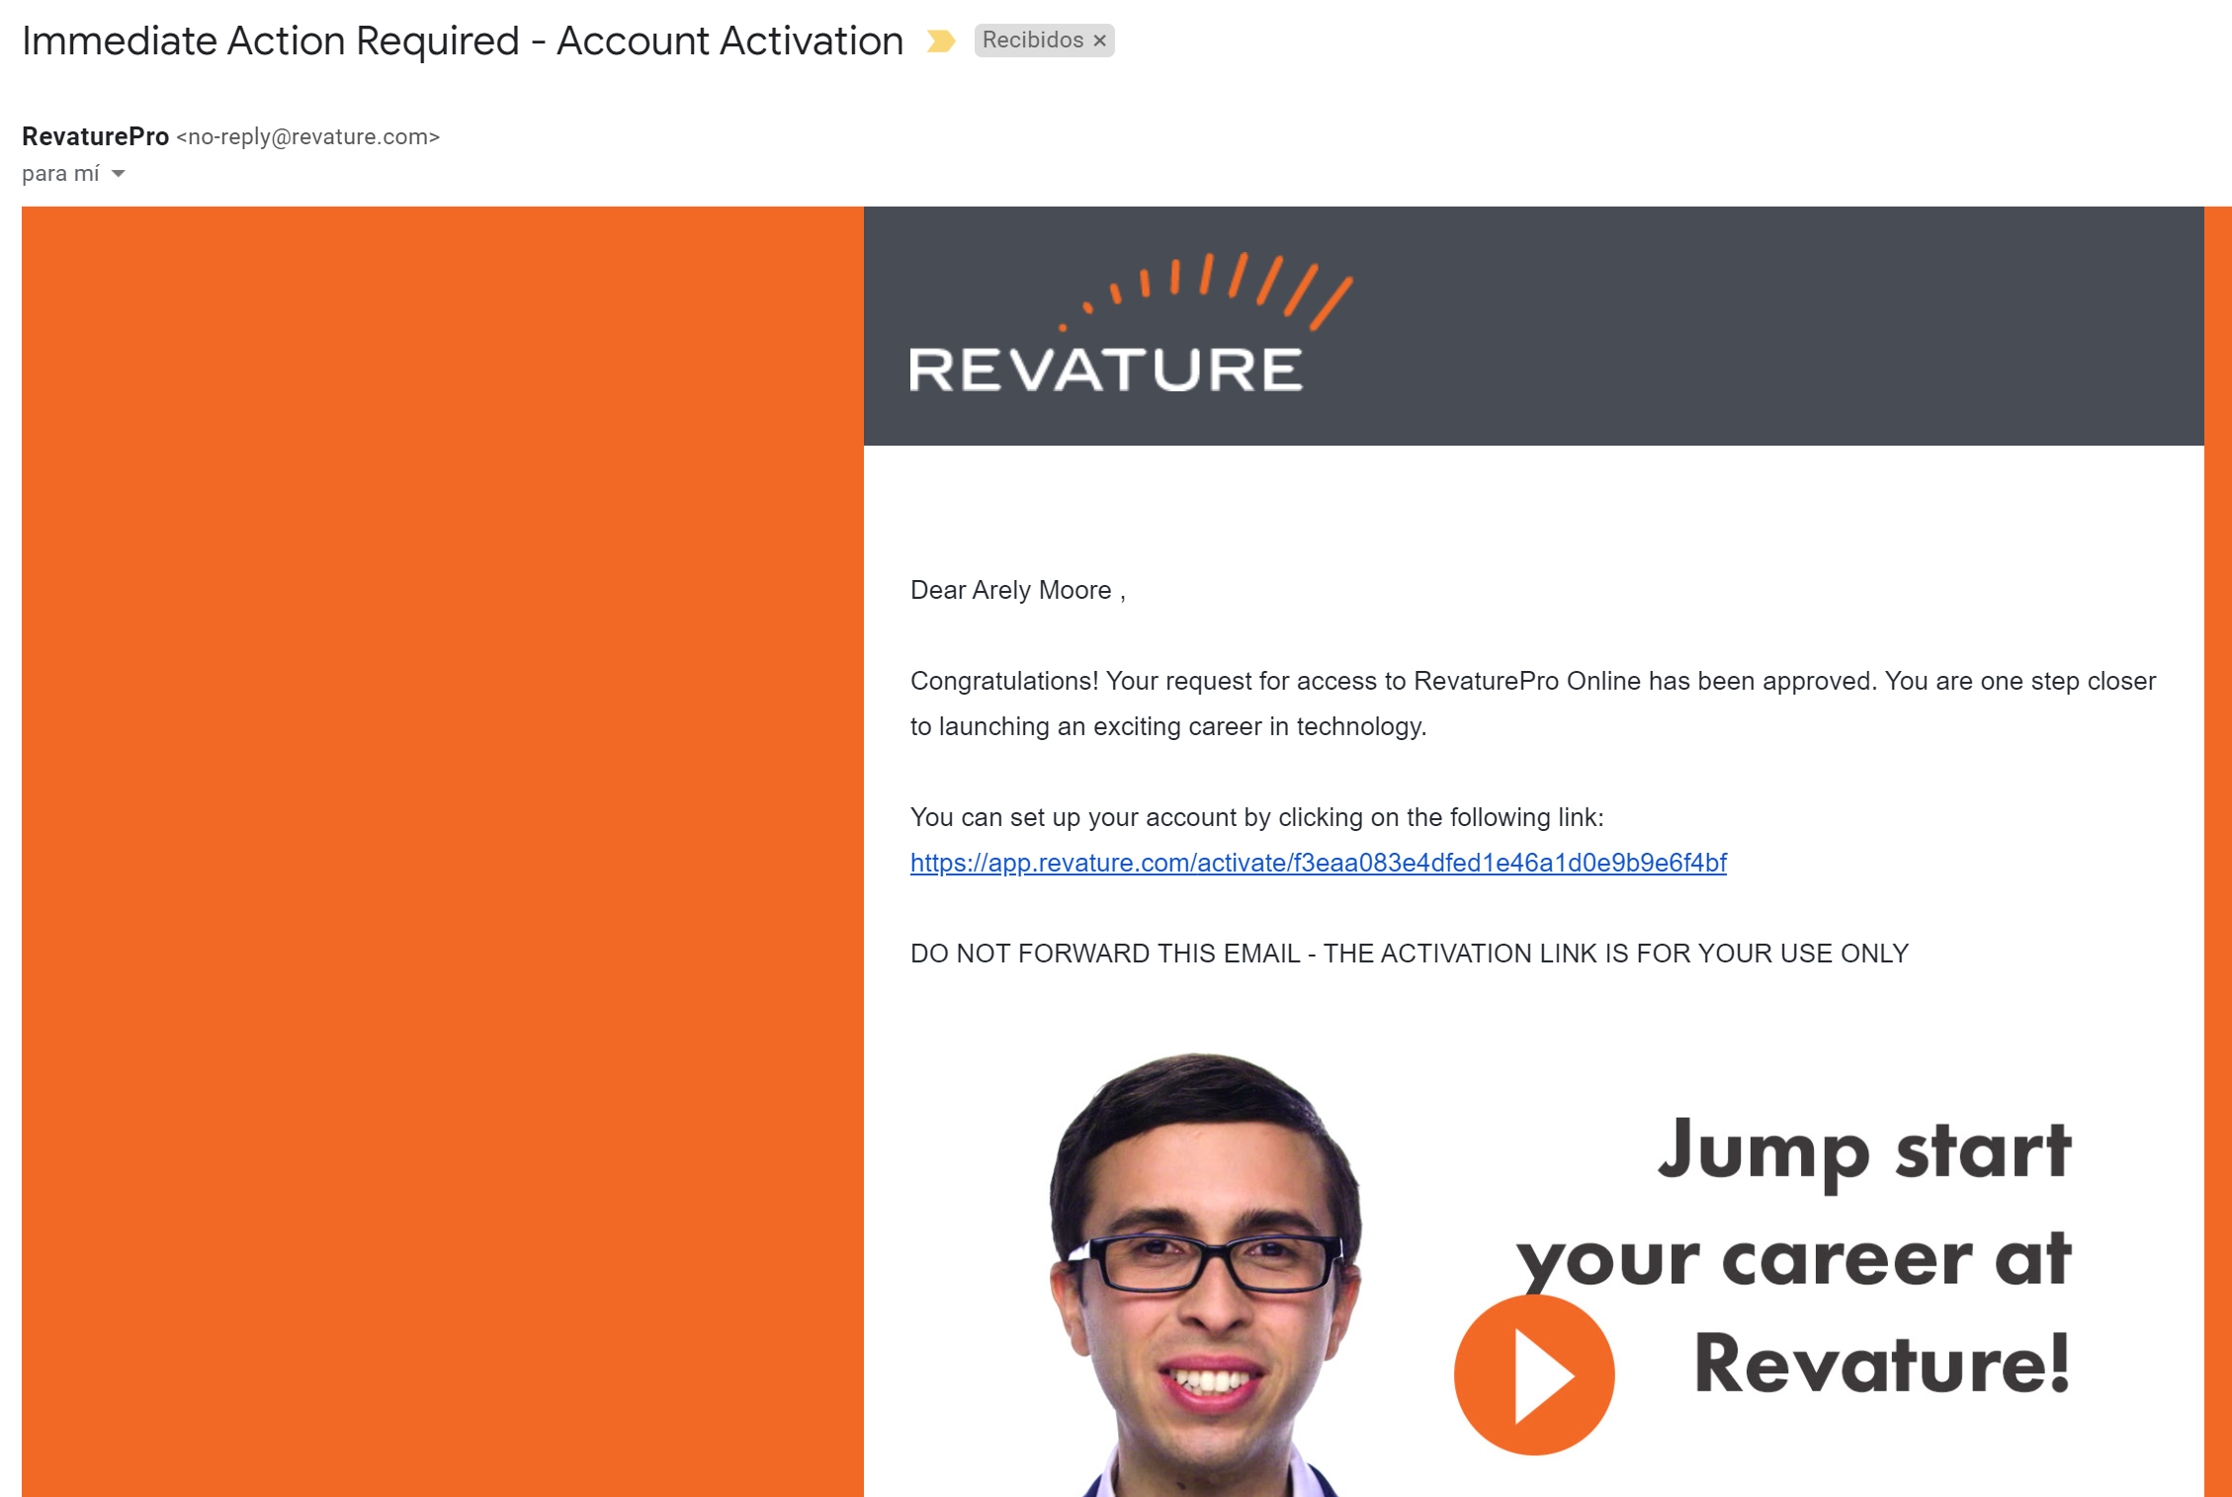
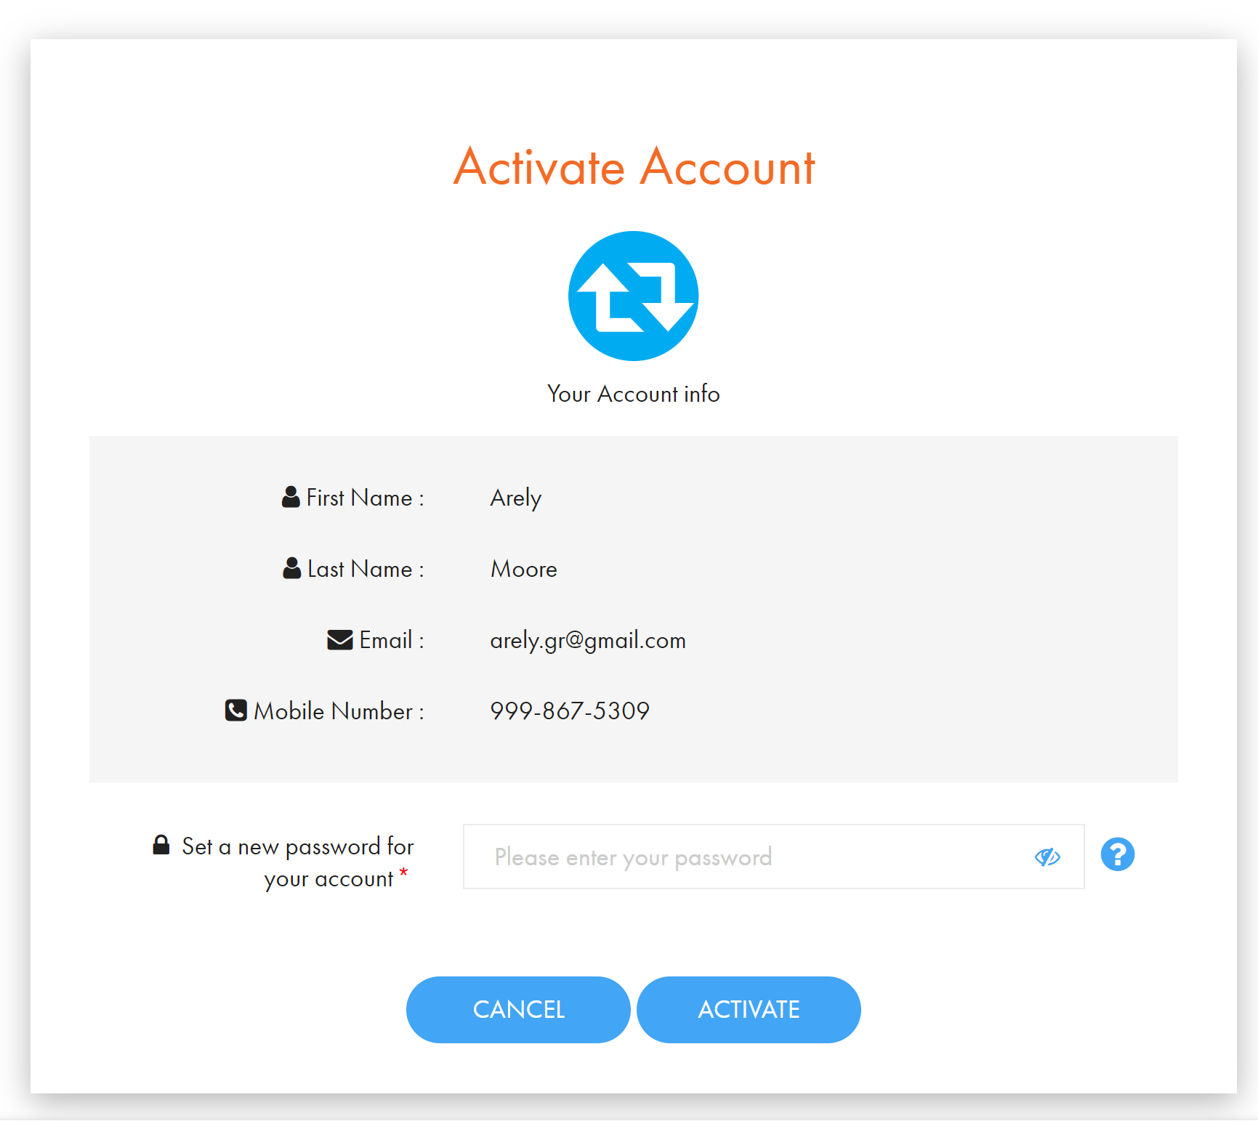
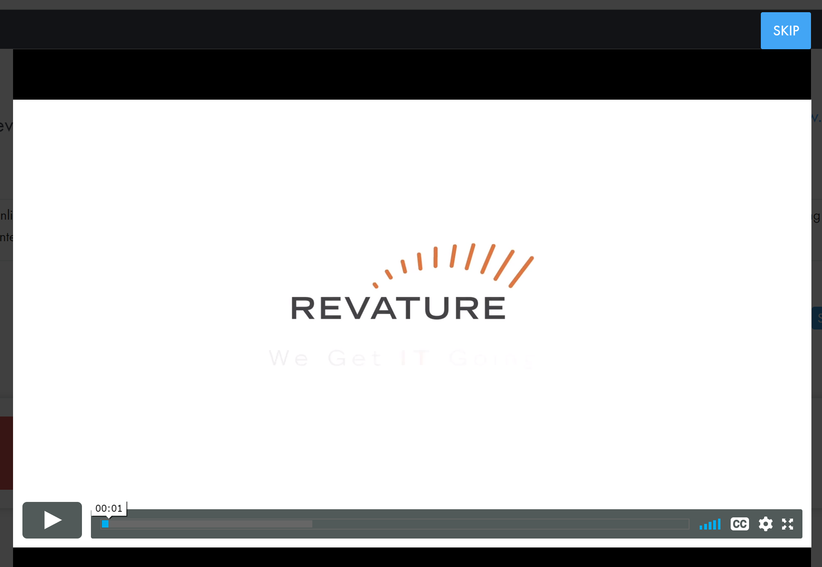
Revature Pro Setup https://app.revature.com/login https://revature.com/signup/
Log into your professional email and confirm your RevaturePro registration by clicking the link provided.
Give yourself a unique, robust password to be used with RevaturePro from now on.
Click ACTIVATE to gain access to your RevaturePro account.
You can watch the introductory video or skip.
You will automatically begin the tour to familiarize you with the RevaturePro Platform.

Slide 4
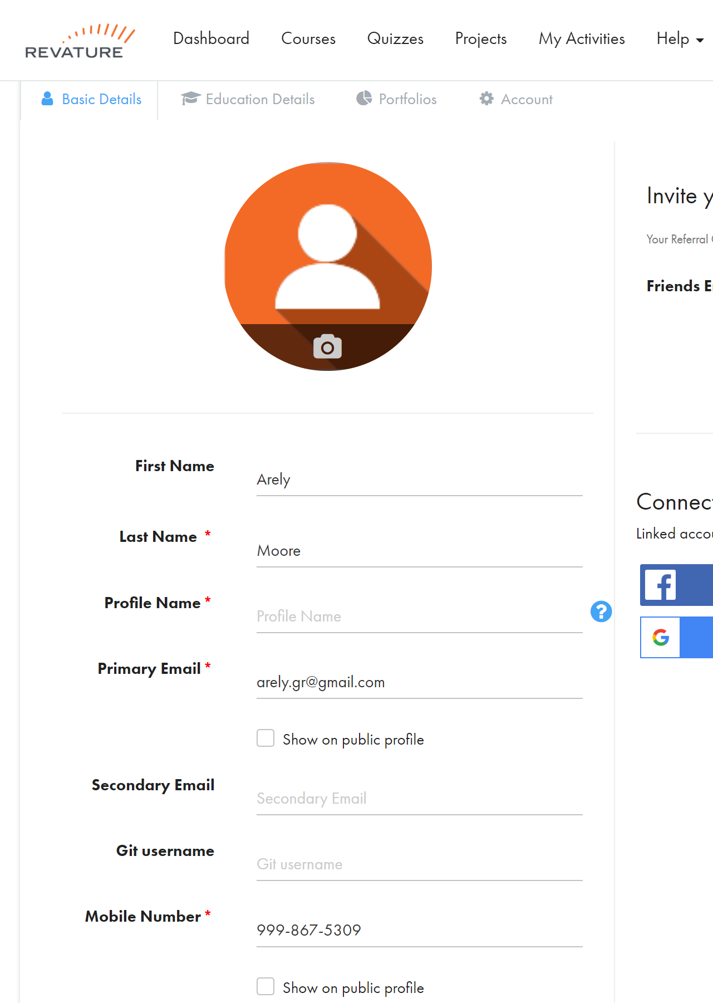
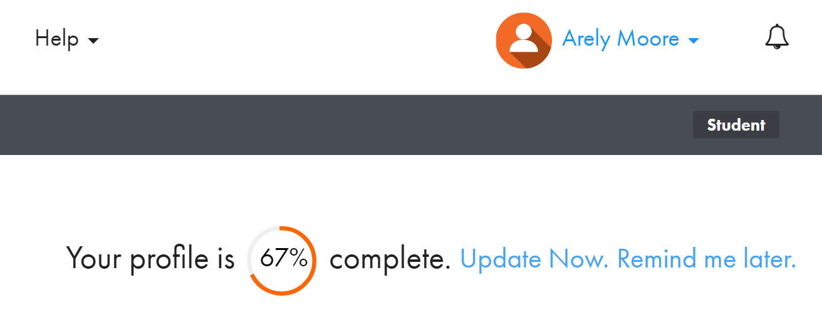
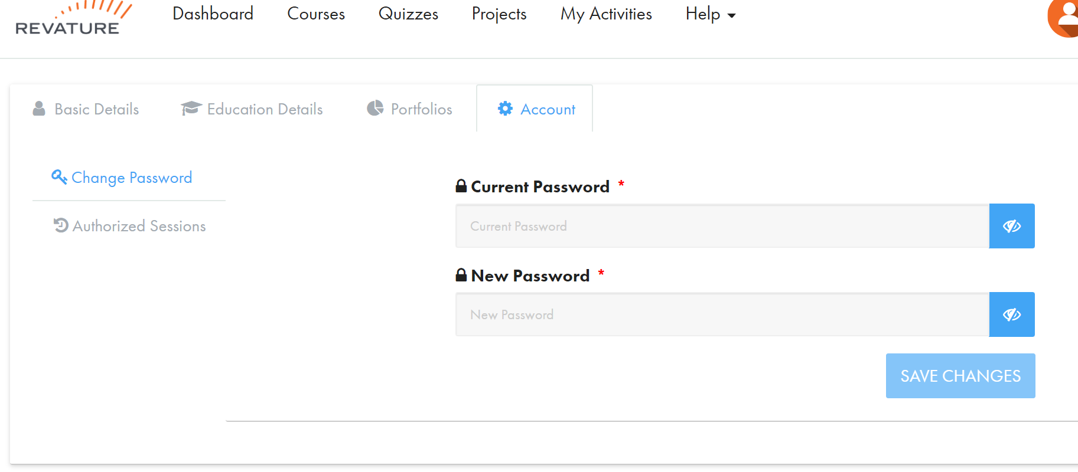
Revature Pro Setup https://app.revature.com/login https://revature.com/signup/
After completing the tour, you can click “Update Now” to complete/update your profile.
You can also create a screen name, add an email, a profile image, etc.
Enter your Github UserName. We will use this to deliver Github Classroom assignments and for grading.
Under Account you can change your password.

Slide 5
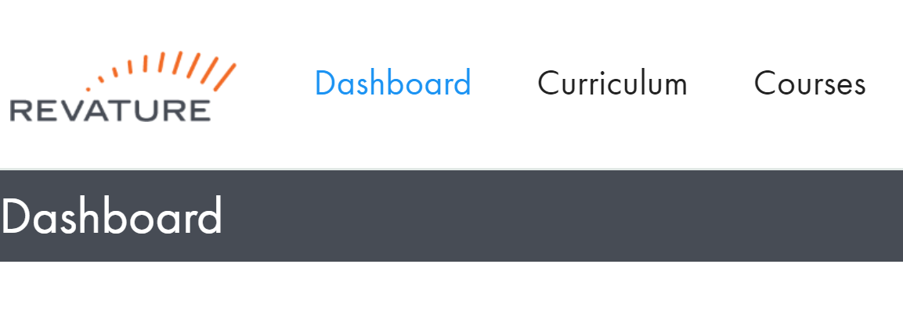
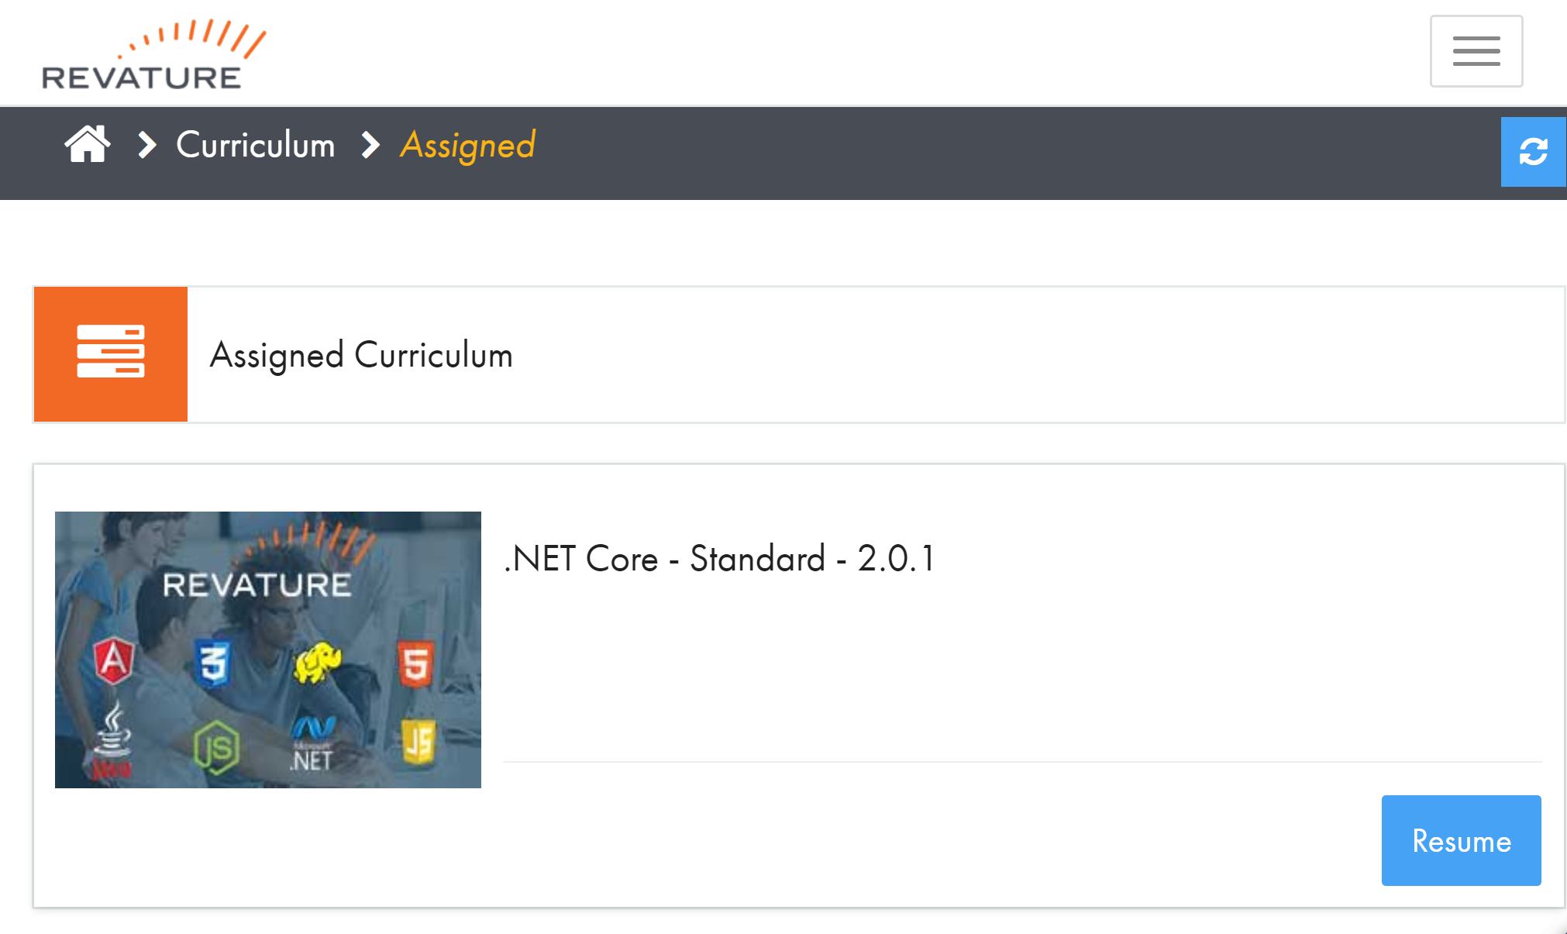
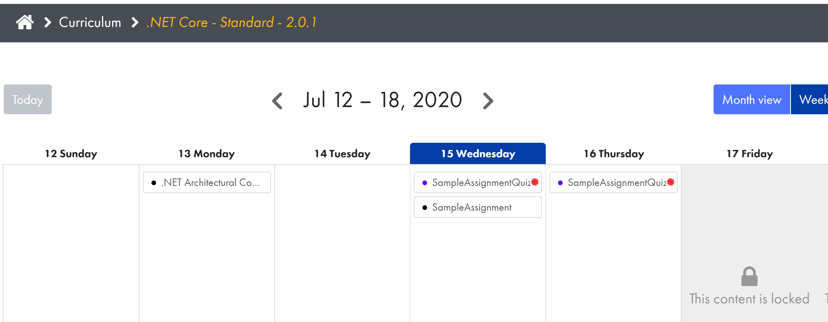
Revature Pro Setup https://app.revature.com/login https://revature.com/signup/
After you have been assigned to the class, you will have a “Curriculum” option in the top Navigation bar.
Click “Curriculum” to access the Training resources.
Click “Start”/”Resume” to see the assignments in a calendar form.
Click on any available assignment to access the resources, projects, or quizzes.

Slide 6
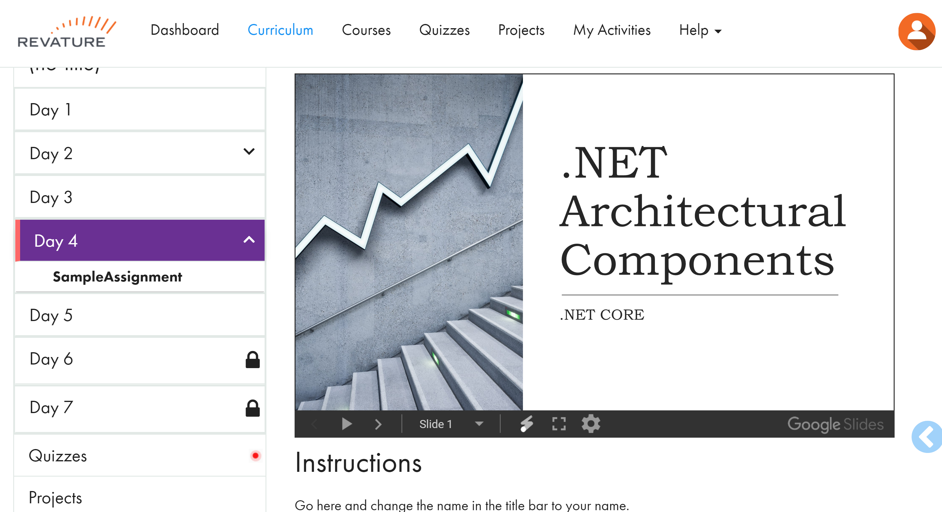
Revature Pro Setup https://app.revature.com/login https://revature.com/signup/
If you click on the Lecture (here called SampleAssignment), you are taken to a screen with the days of the selected week in the left-hand column and the chosen lecture in the main section.
Controls for the presentation are along the bottom of the presentation
Below the presentation are Instructions for completing the assignment and additional information to accompany the presentation.
At the bottom of the left-hand column you can find all assigned quizzes and project assignments.

Slide 7
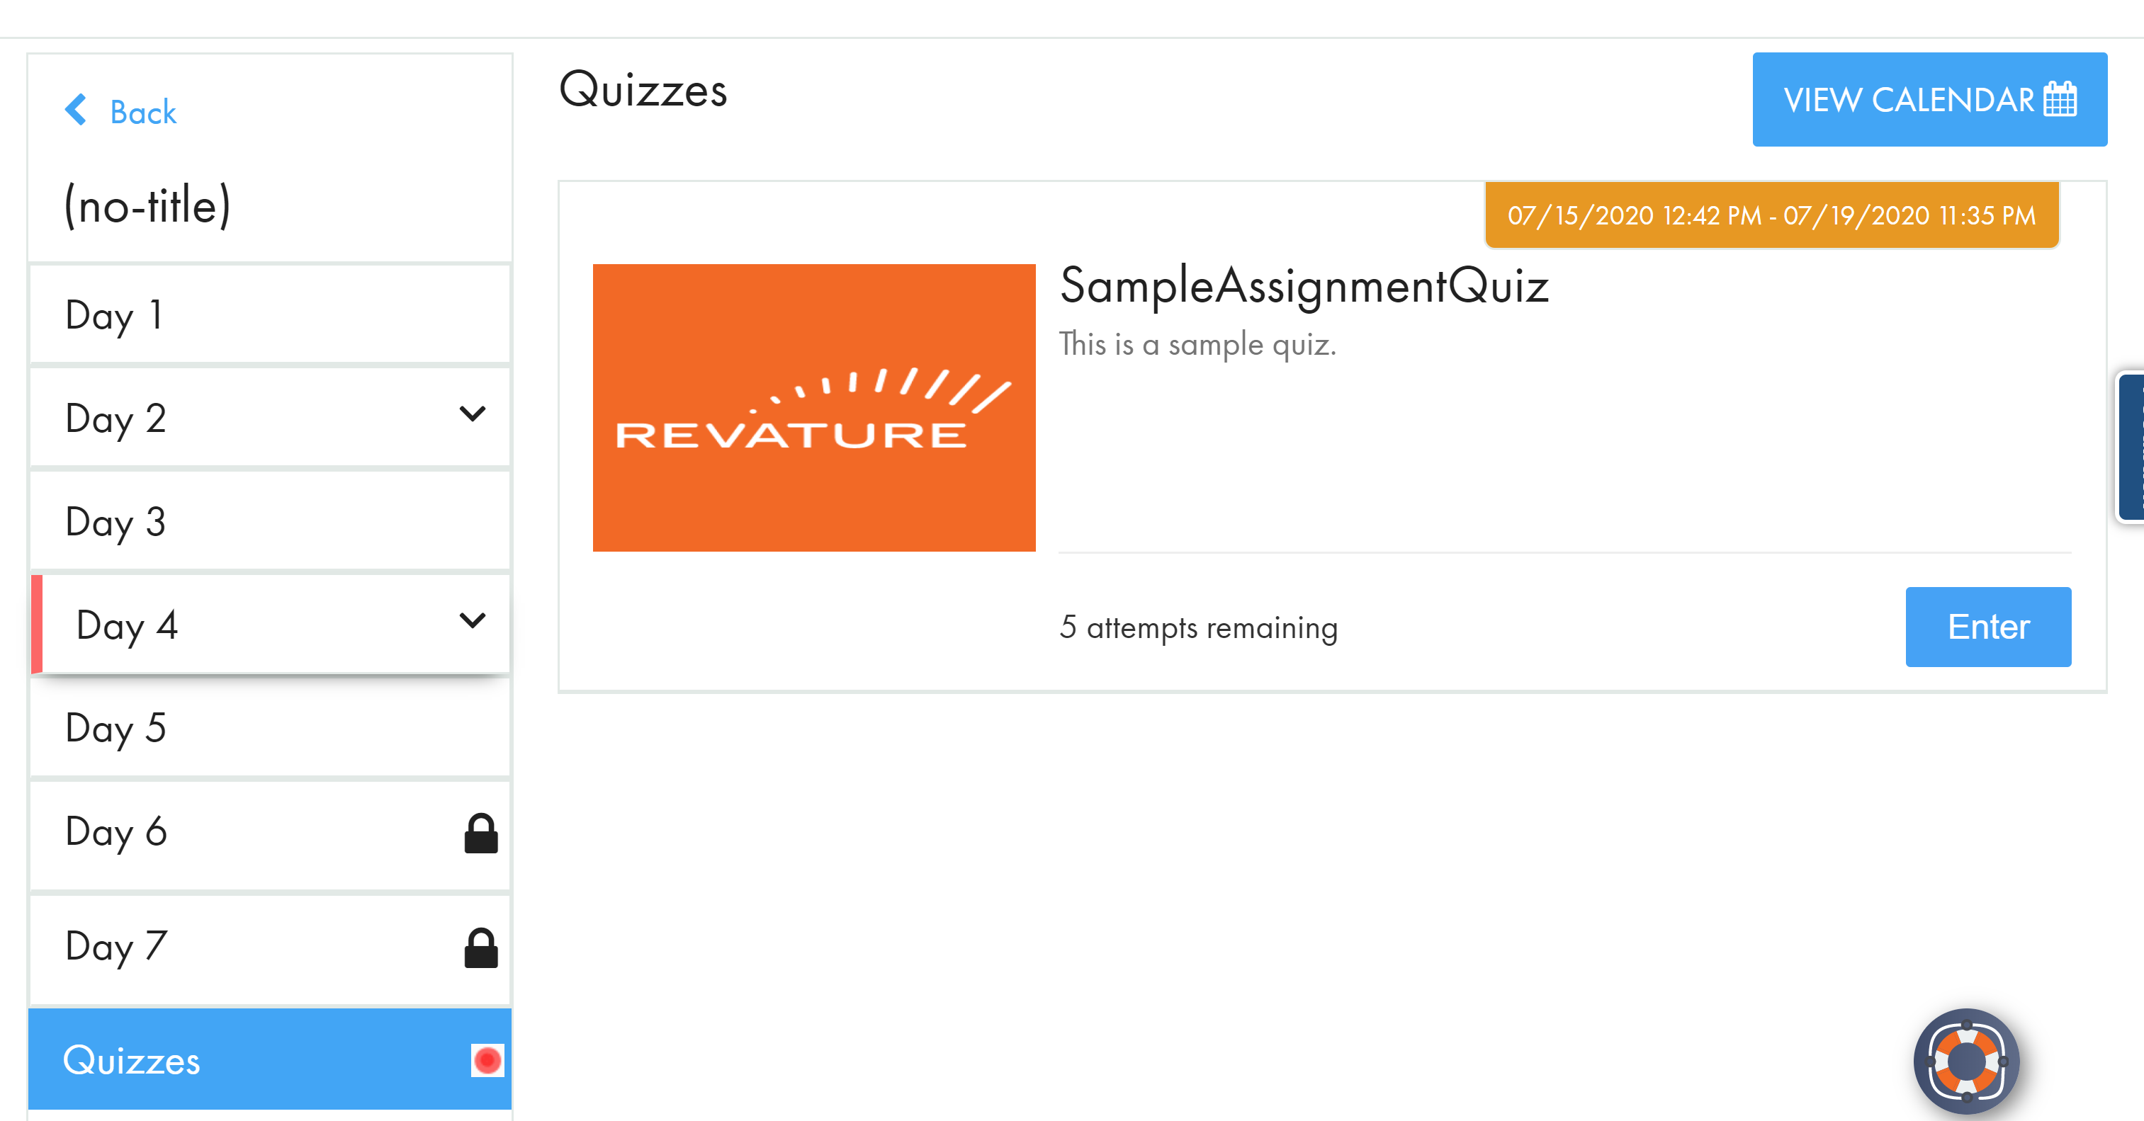
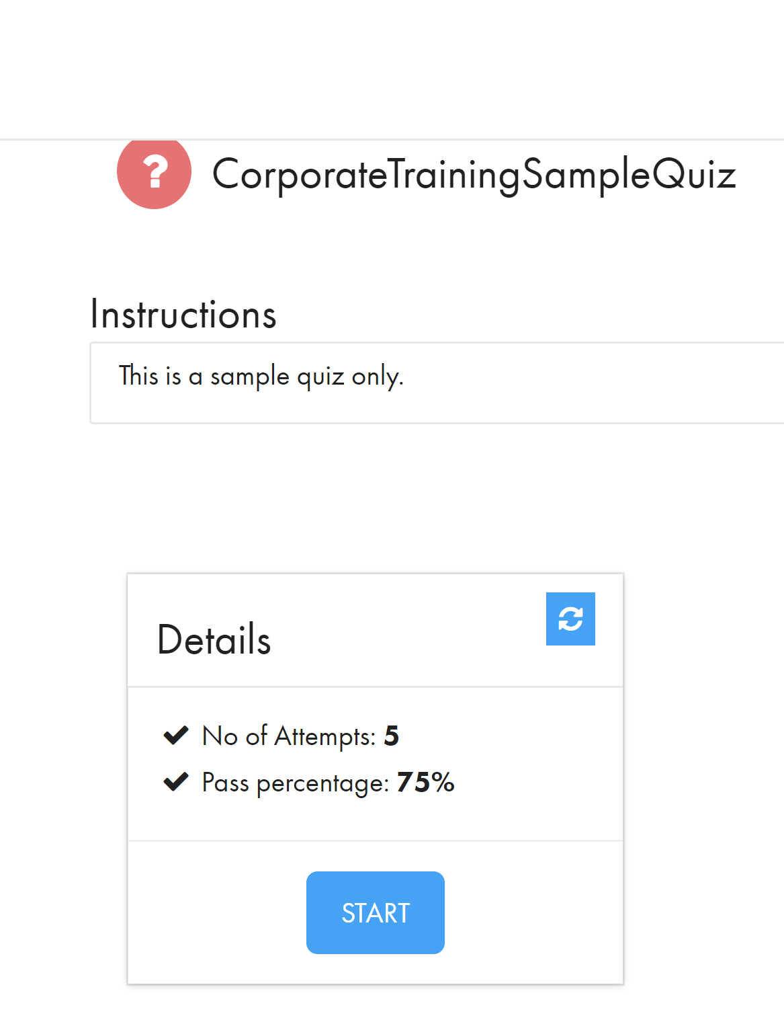
Revature Pro Setup https://app.revature.com/login https://revature.com/signup/
Click on the “Quizzes” tab on the bottom of the left-hand column to access the quiz for the Lecture Presentation.
Click Enter to access the quiz.
You will be taken to a page with further instructions (when necessary).
Click START to begin the quiz.
In this program you will have 5 attempts to complete each small quiz and

Slide 8
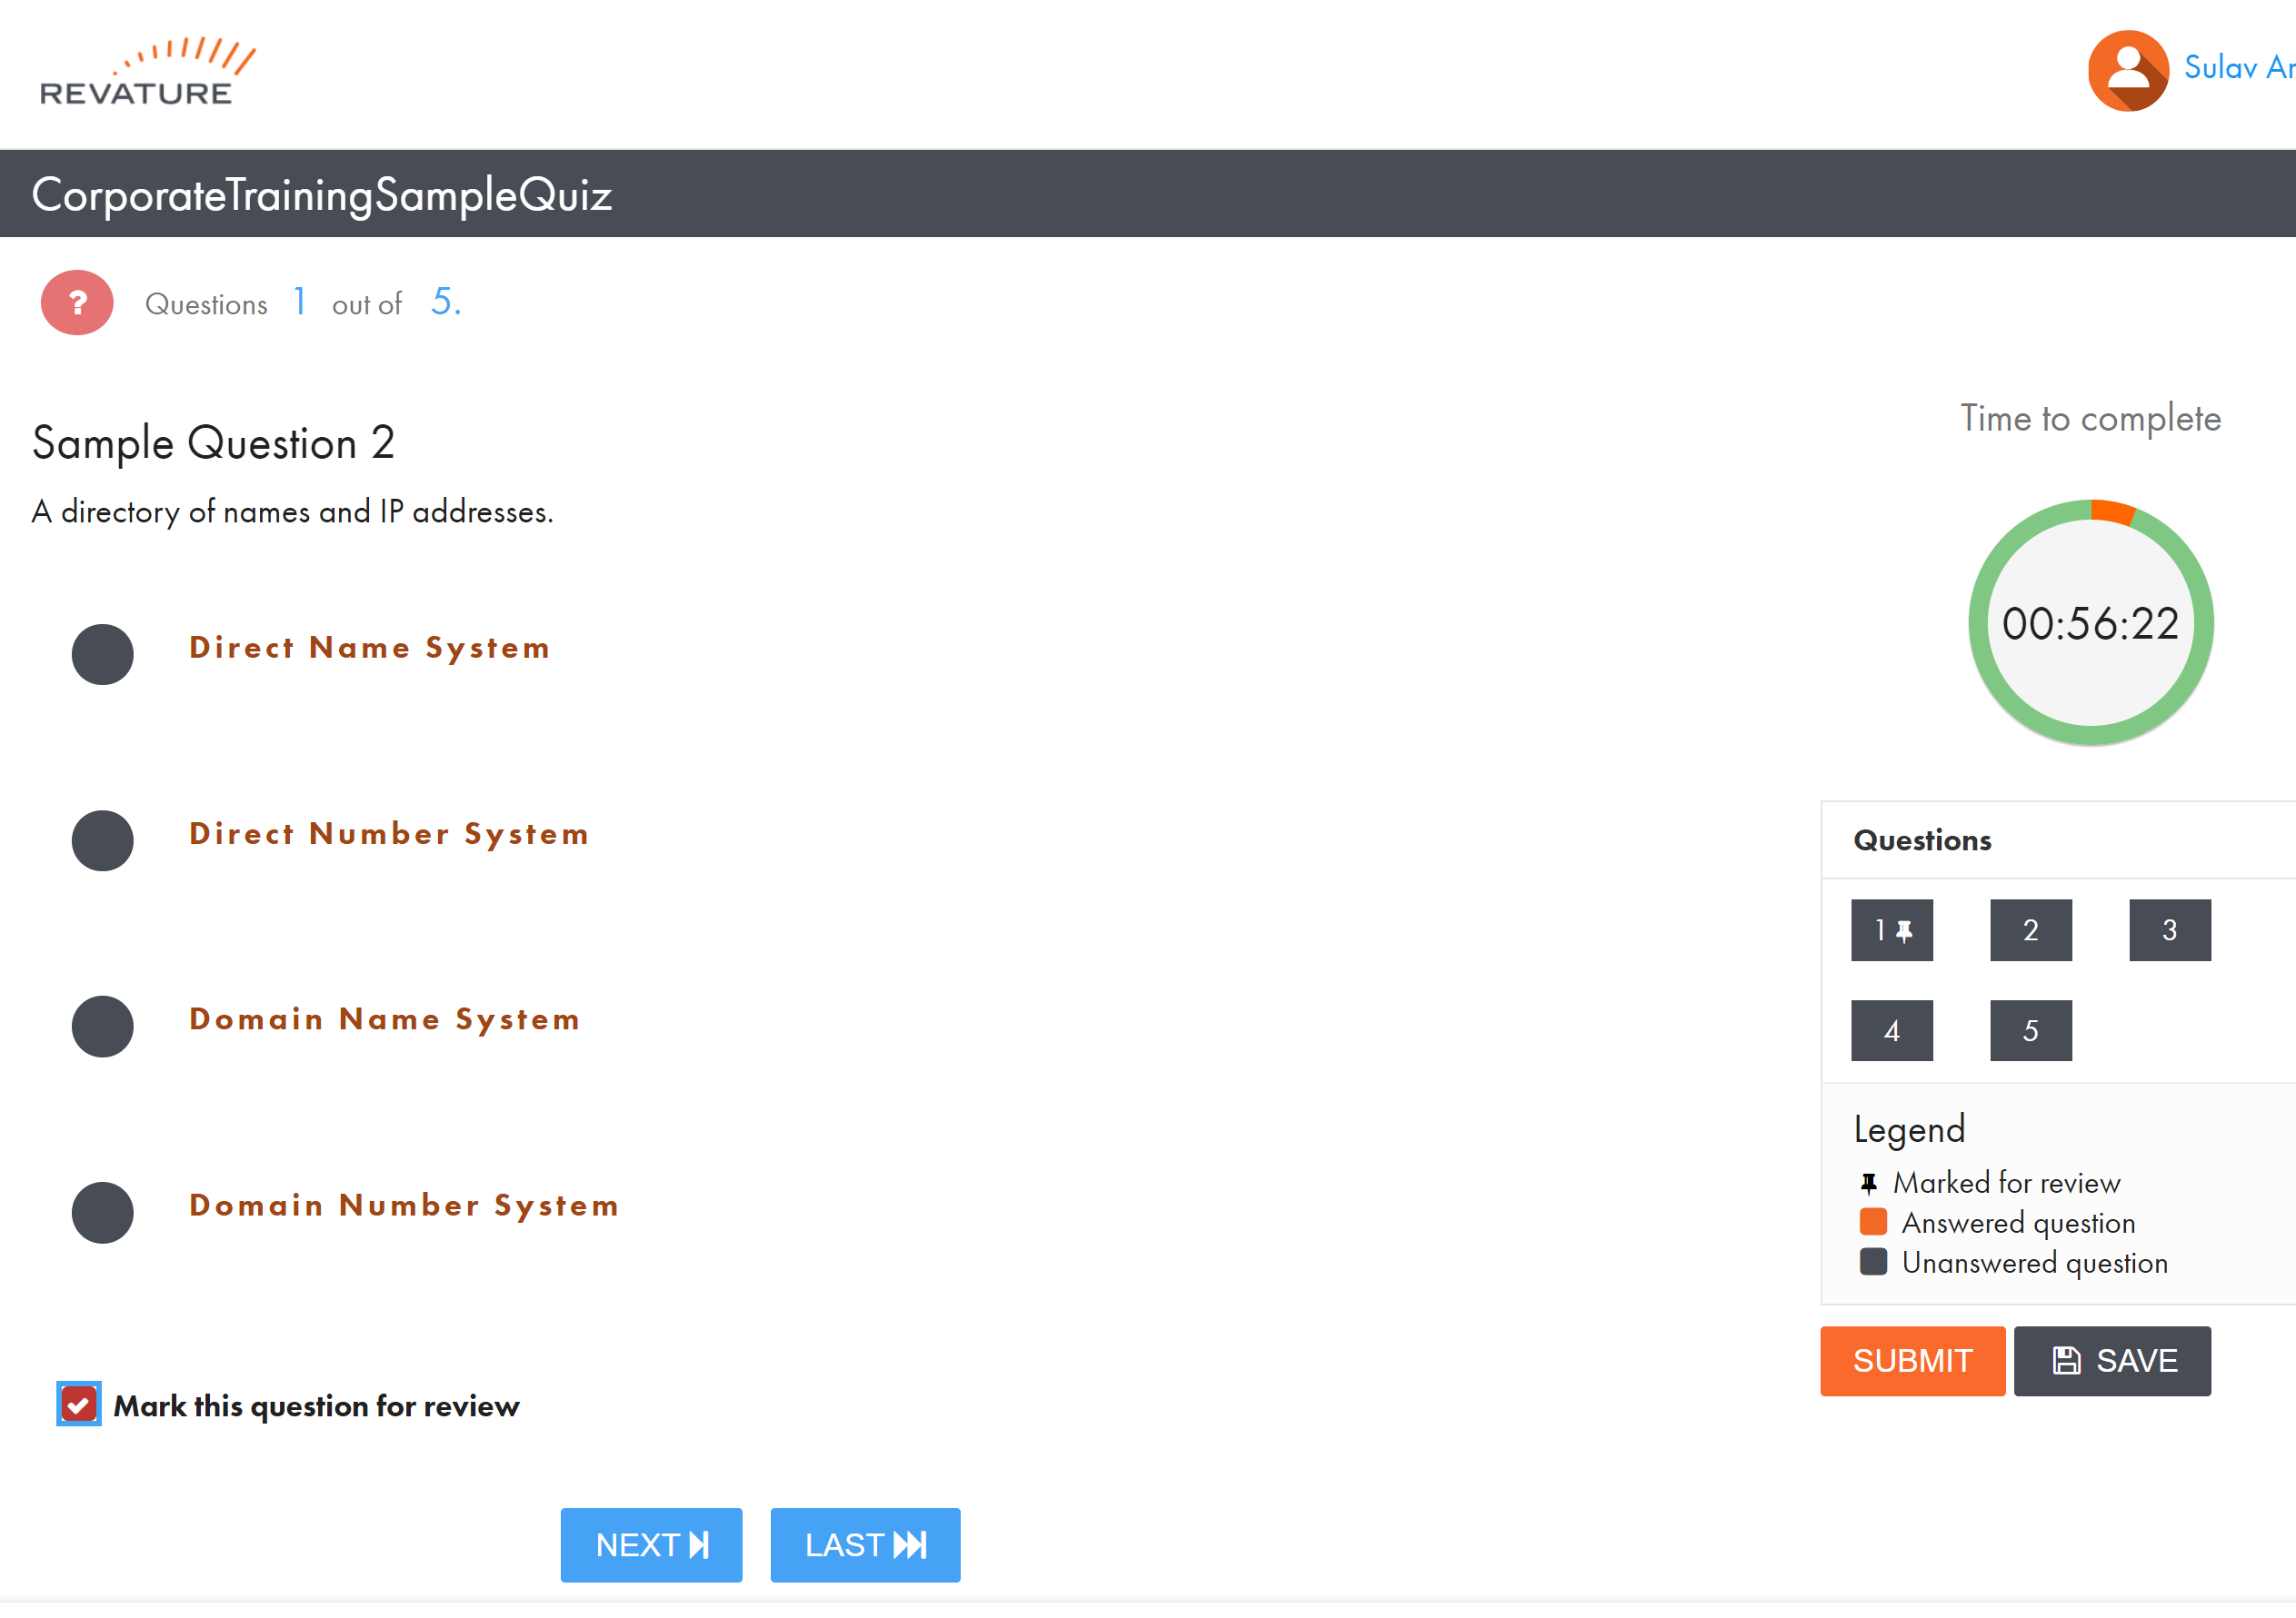
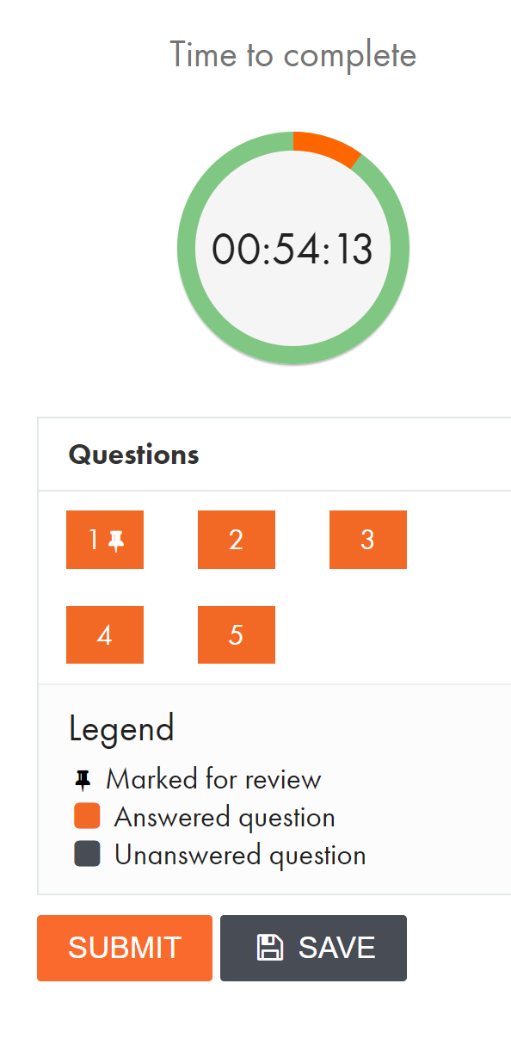
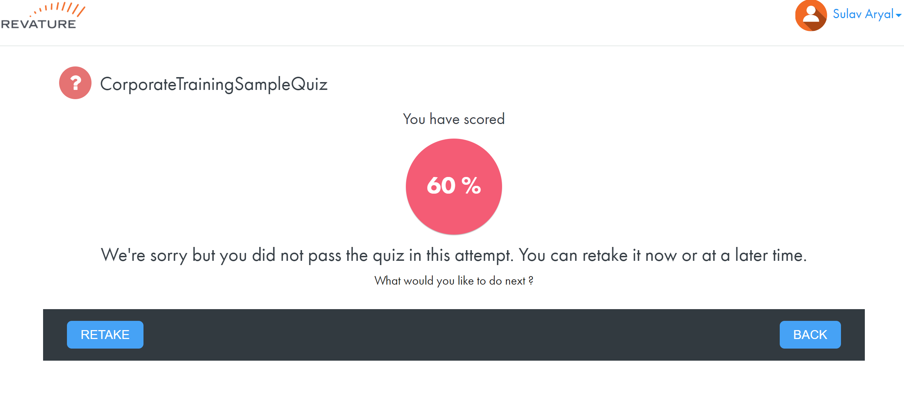
Revature Pro Setup https://app.revature.com/login https://revature.com/signup/
During a quiz, you have the current question, a time-remaining clock, and a grid pattern to enable you to switch between questions.
You can also mark questions for review later. Questions marked for review have a pin next to them in the grid.
Answered questions are shown in orange.
After completing the quiz, click SUBMIT.
You will be shown your score.
You may retake the quiz to get a passing score.

Slide 9
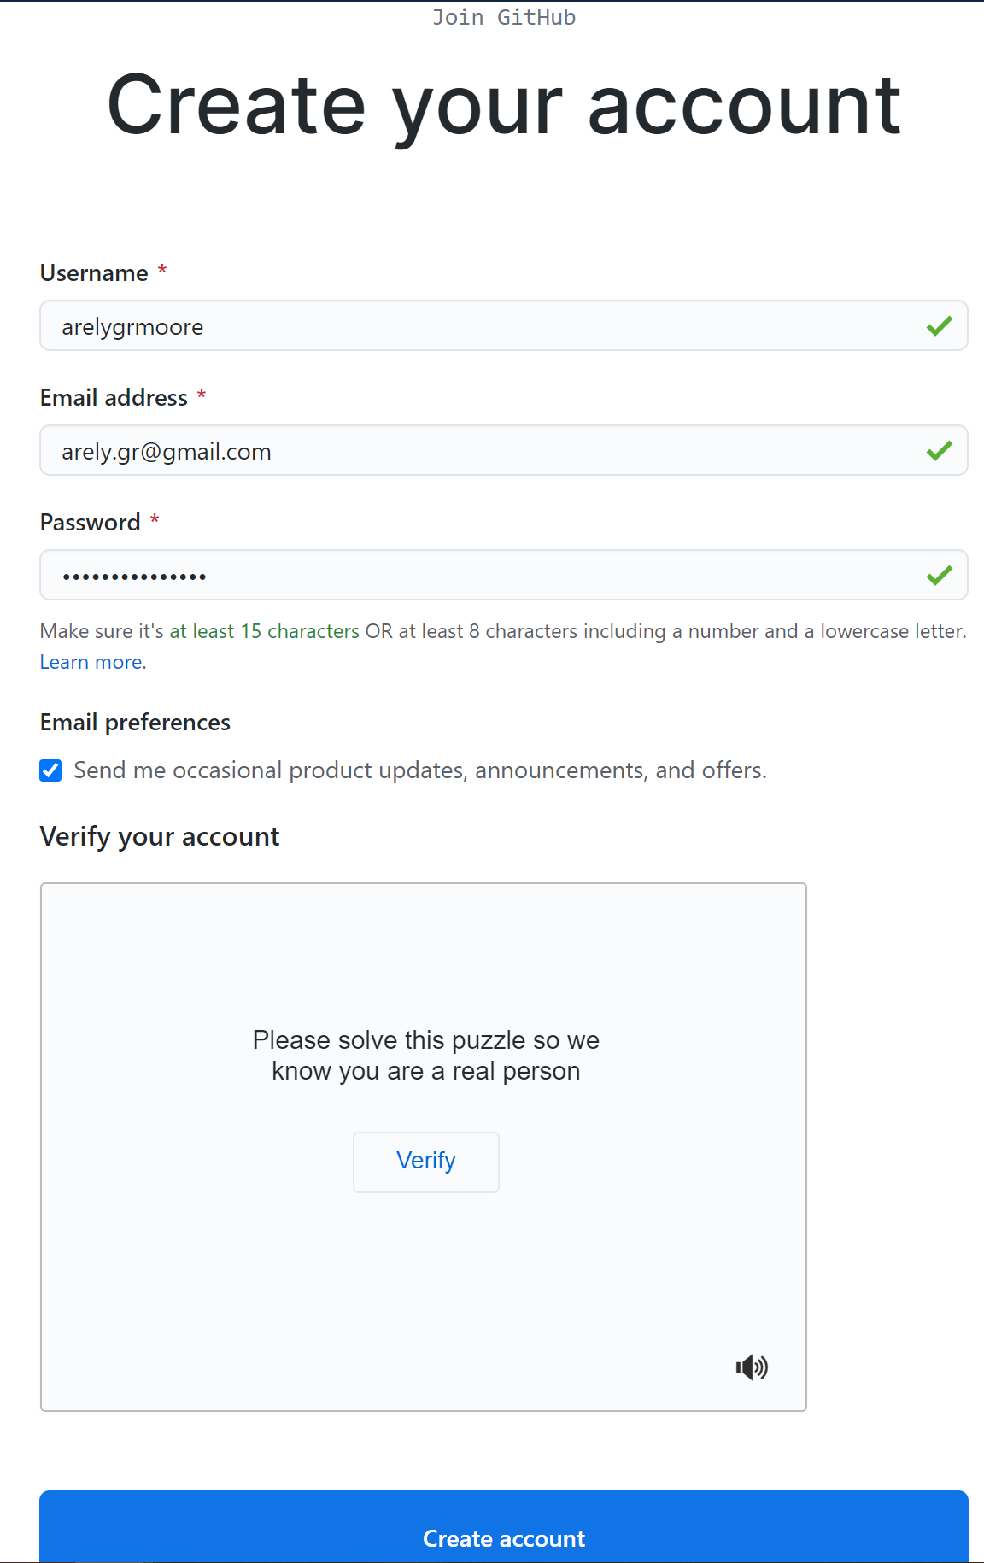
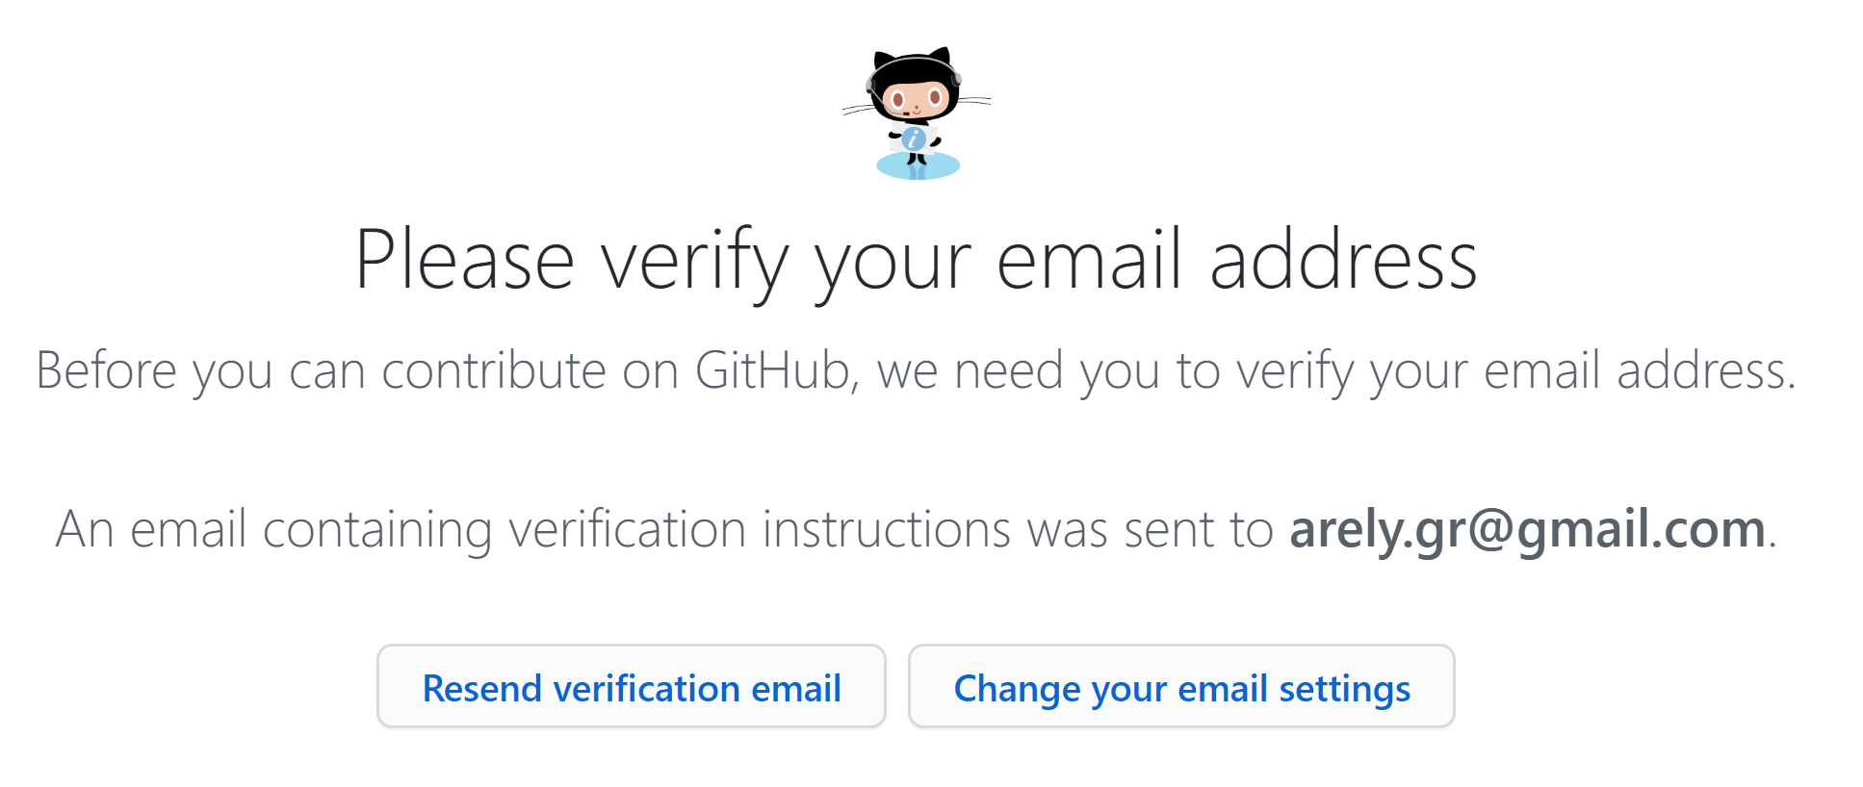
Github Setup https://github.com/join?ref_cta=Sign+up&ref_loc=header+logged+out&ref_page=%2F&source=header-home
If you already have a github.com account, you do not need to create a new account.
CTRL-click this link to create a new Github Account (if you don’t already have one).
Complete the other sections of Github setup as appropriate to you.
Log in to your professional email to complete setup of your Github account.
After verifying your email address, you do not have to do anything else, such as Create a repository or organization.

Slide 10
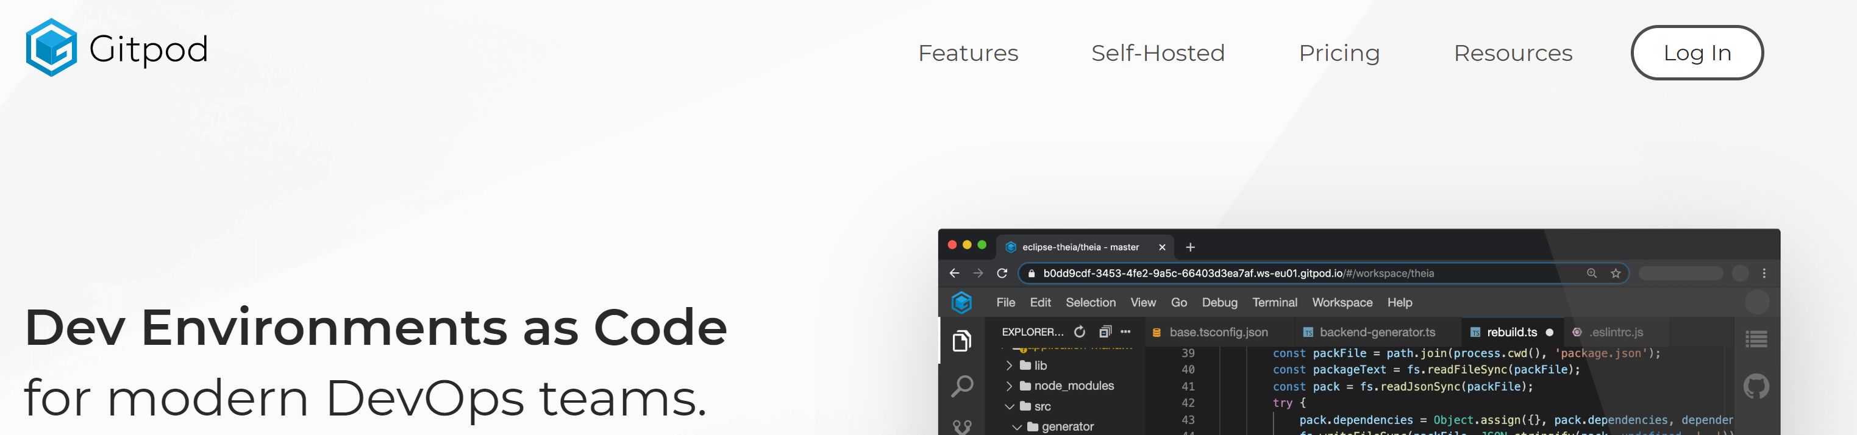
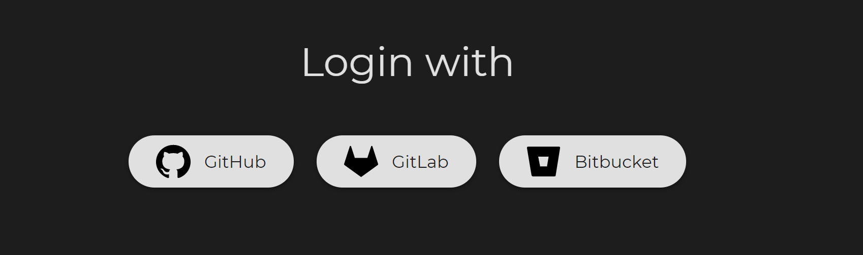
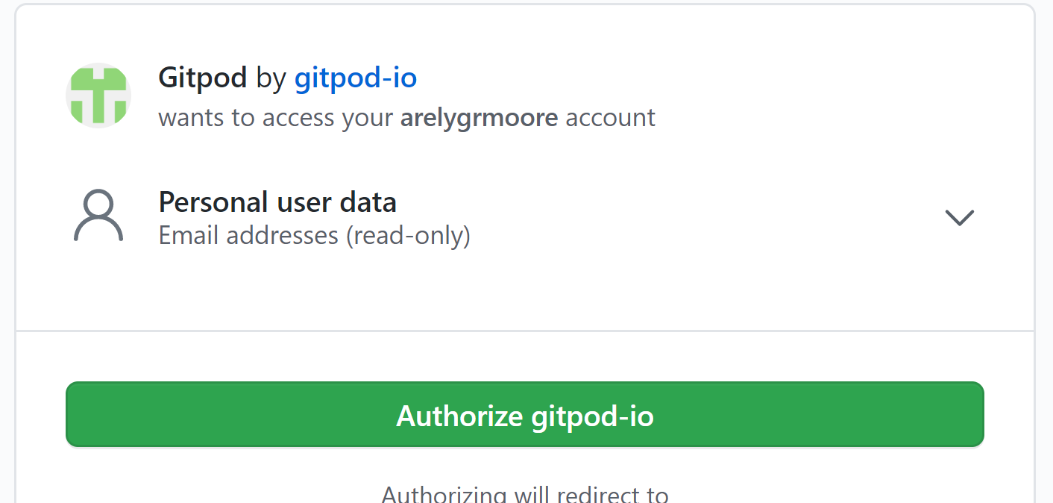
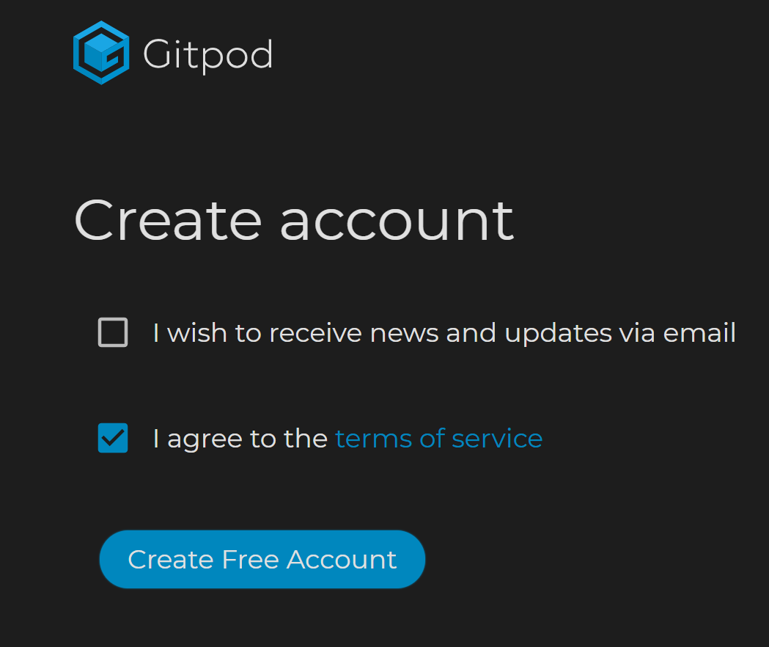
Gitpod Setup https://www.gitpod.io/
Ctrl-click this link to Log in to Gitpod.
Use your Github account to log in.
Make sure Gitpod wants to access your Github account.
Authorize Gitpod.io.
No other action is necessary on Gitpod.

Slide 11
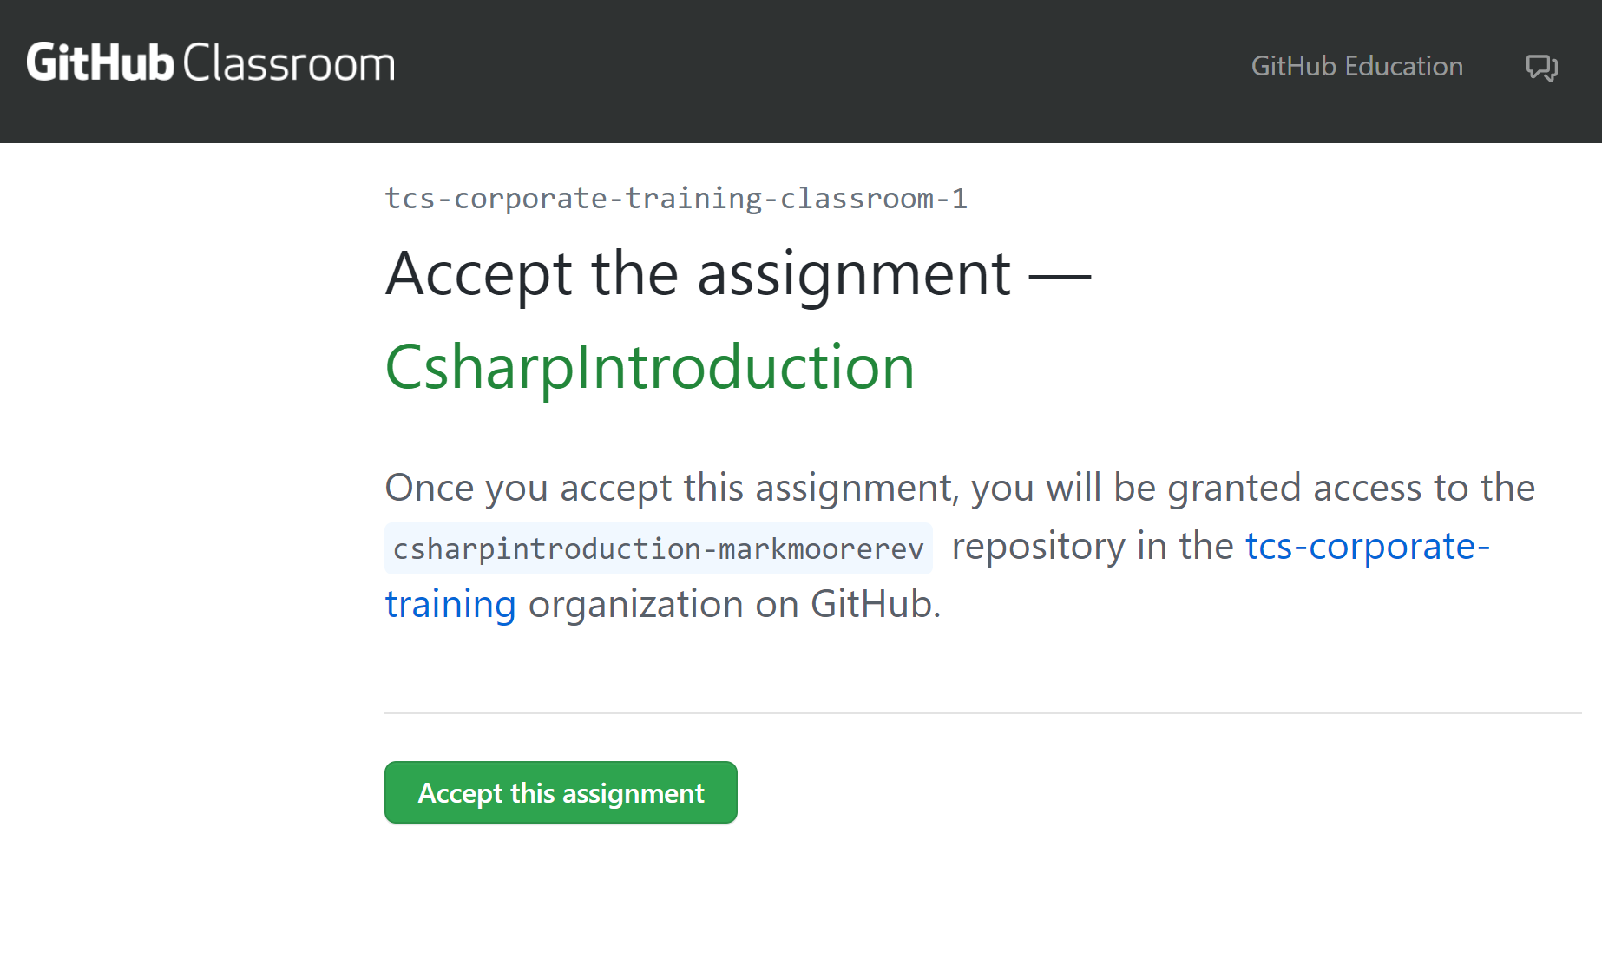
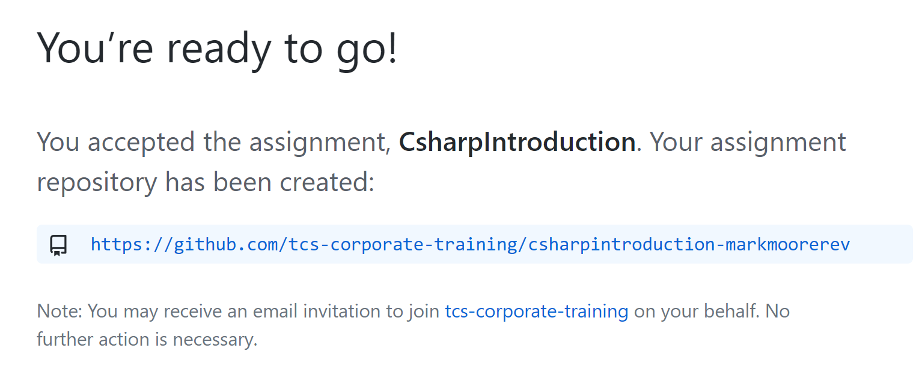
How to accept an assignment from Github Classroom.
Click the invite link in the RevaturePro lecture.
Make sure you are logged into your Github account and click to accept the assignment.
If you want to complete the assignment in Gitpod, just add `gitpod.io/#` in front of your repo URL ( Ex. gitpod.io/#https://…). You may need to grant access to Gitpod.
If you want to complete the assignment on your local machine, use git commands to clone the new repo locally and follow the instructions to complete the assignment.

Slide 12
How to accept an assignment from Github Classroom.
You do not need a Github Classroom account.
Click the invite link in the RevaturePro lecture.
Make sure you are logged into your Github account and click to accept the assignment.
If you want to complete the assignment in Gitpod, just add `gitpod.io/#` in front of your repo URL ( Ex. gitpod.io/#https://…). You may need to grant access to Gitpod.
If you want to complete the assignment on your local machine, use git commands to clone the new repo locally and follow the instructions to complete the assignment.

